Slide 1

VyapaarDirect
Code For Good - 2019
Bringing in the Local Flavour at your Doorstep.
Team 18
Bhaskar Singh
Nishtha Tiwari
Arushi Goyal
Jatin Grover
Biswajit Mohanty

Slide 2

Mission : Mentoring Local Businesses to Scale Up their Market and help them Succeed.

Slide 3

The Current Scenario
Small Businesses restricted to their locality.
Lack of Technology in the rural economic centres.
Meagre Revenue generation for small businesses.
Lack of Knowledge reagrding local businesses in people.
No Tech Platform for people to connect to small businesses.
Hence, it’s difficult for small businesses to thrive.

Slide 4

Our Solution
Discovery of Local businesses through Map.
Search business by Service/Product.
Services/Products shown according to availability and location.
Online ordering portal for the service/product.
User friendly, self-explanatory UI for the vendor-side.
Navigation to vendor through Google Maps

Slide 5

Our USP
Sales for the day measure to track impact of software.
Rating metrics provided to the product/service.
Best Performing business in the locality.
Scalable and Reliable System
Usage of Open Source softwares for development eg: MySQL

Slide 6

The Technologies Used:
WEB: HTML, CSS, JavaScript , Bootstrap.
Amazon Web Services: EC2 Server
Database: MySQL
Servers: Flask

Slide 7

FutureScope
Cross Platform progressive web app can be deployed for the same.
Live Tracking of the Order on Delivery.
Personalized recommendations on products/services.
Suggestive measures to vendors for scaling up their businesses.
SMS alerts using AWS.
Chat window between the vendor and the customer aiding to quality assurance.

Slide 8
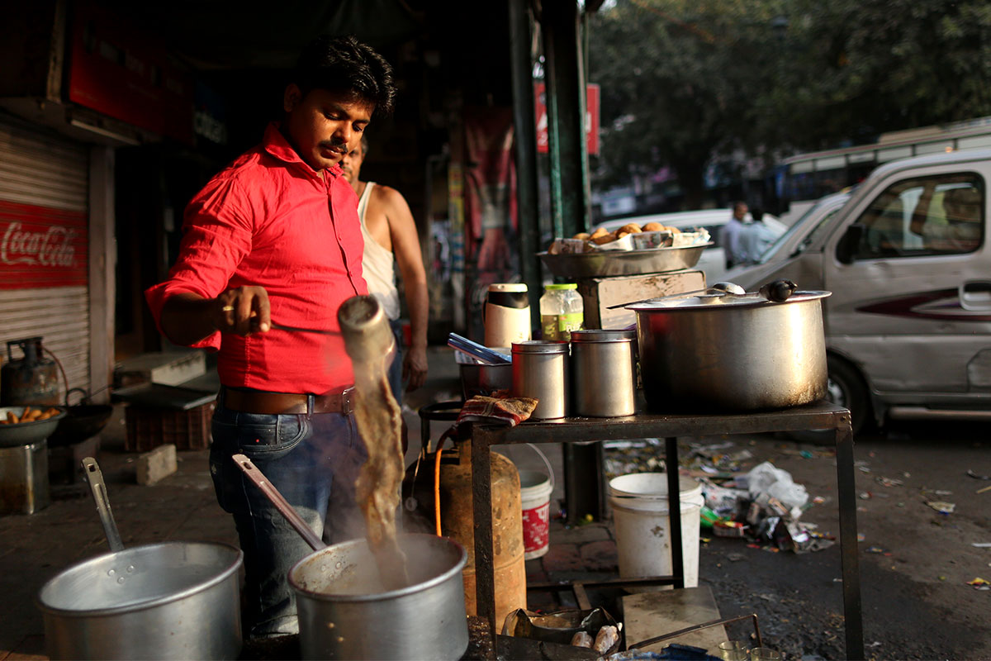
Thank You!

